Slide 1
Intro to Android Development
Lecture 3: Intents and manifest

Slide 2
Intents
Communication between app components or from inside to outside the app
Two types of intent: explicit and implicit

Slide 3
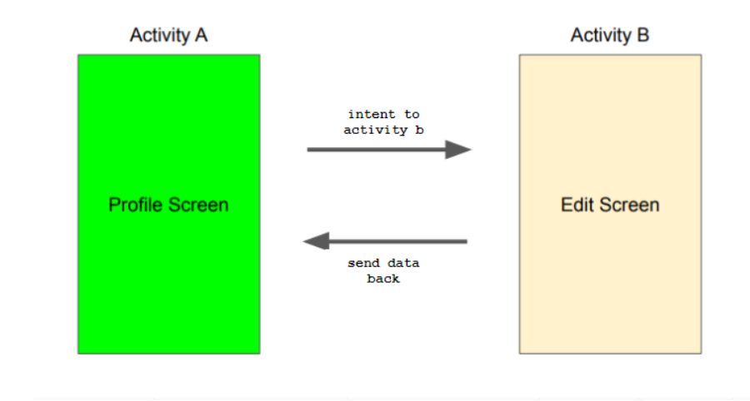

Slide 4
Explicit vs Implicit
Explicit
Implicit
Use to launch other activities in your app
For example: clicking the heart on instagram and getting redirected to the notifications page
Request to perform an action based on a desired result
For example: clicking to share information to another app

Slide 5

Explicit vs Implicit
Explicit
Implicit
Request to perform an action based on a desired result
For example: clicking to share information to another app

Slide 6
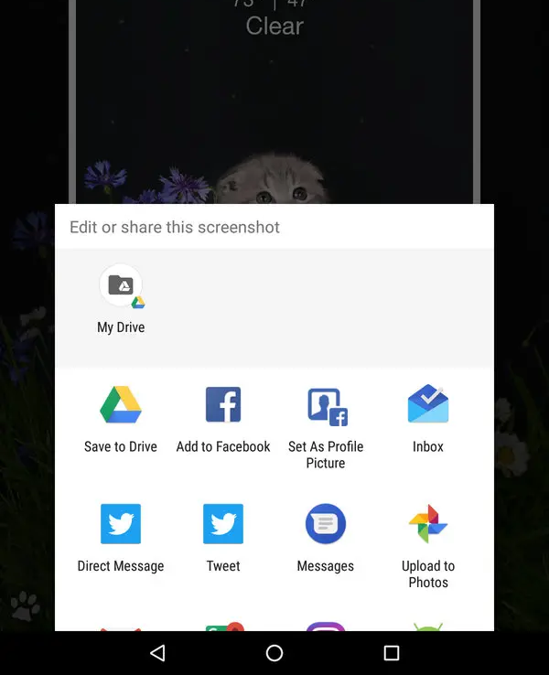
Explicit vs Implicit
Explicit
Implicit

Slide 7
Explicit Intents
Explicit intents are used to launch other activities in your app
Below is the basic format in current activity:
Below is the format in target activity to retrieve info:
val intent = Intent(this,TargetActivity::class.java)
intent.putExtra("EATERY_NAME", "Okenshields")<- passes info
startActivity(intent)
// eateryName = "Okenshields"
val eateryName = getIntent().getExtras().getString("EATERY_NAME")

Slide 8
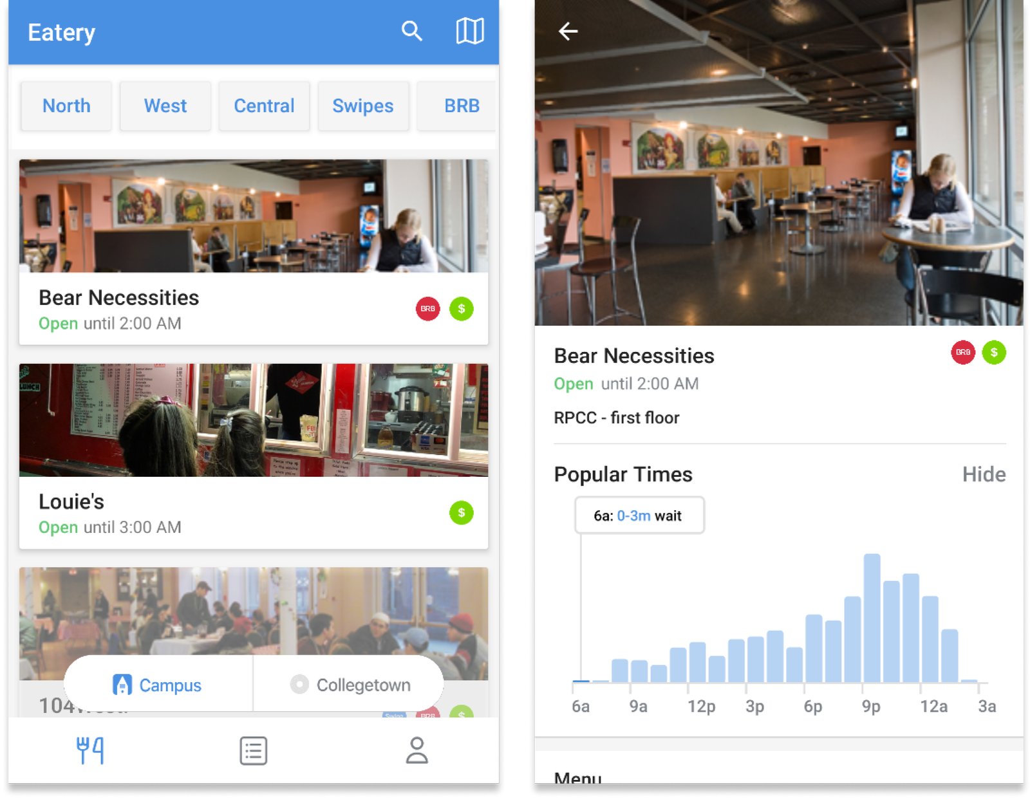
Explicit Intents
Intent eateryName
DATABASE

Slide 9
Implicit Intents
Implicit intents perform an action based on a desired result
They are used when destination is unknown
Google provides a long list of different kinds of intents
Starting a phone call
Sharing information to another app
Opening the browser
Taking a photo

Slide 10
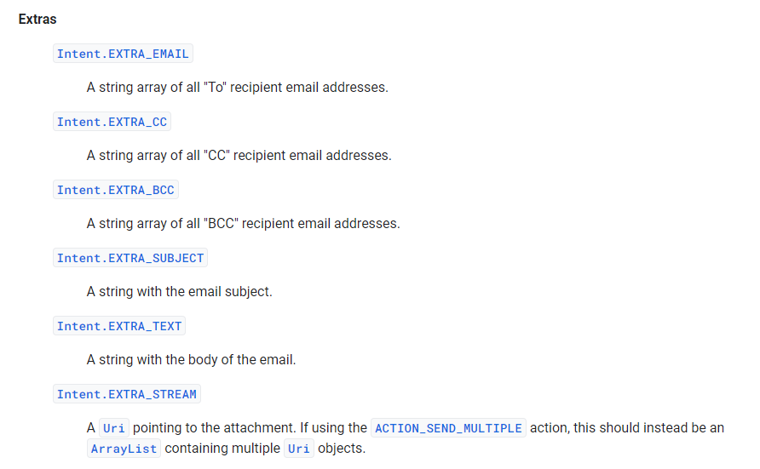
Implicit Intents
fun composeEmail(email, subject: String) {
val intent = Intent(Intent.ACTION_SENDTO).apply {
data = Uri.parse("mailto:")
putExtra(Intent.EXTRA_EMAIL, email)
putExtra(Intent.EXTRA_SUBJECT, subject)
}
startActivity(intent)
}

Slide 11
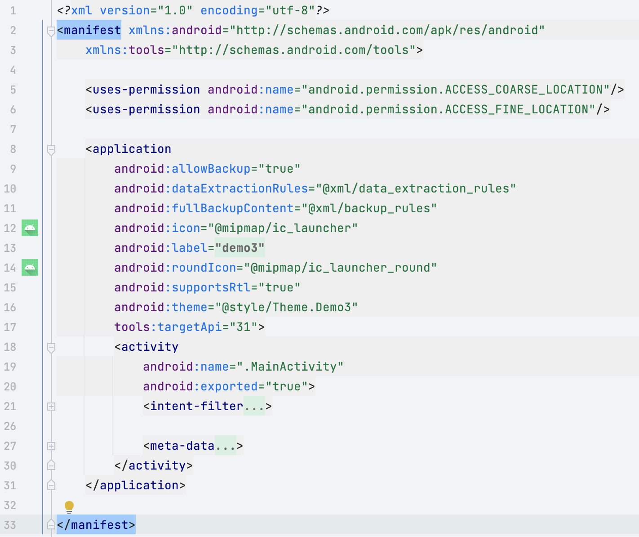
Manifest
The manifest contains information about the app: application’s name, activities and fragments, requested permissions, and software requirements. Each activity in the app must be declared in the manifest. Generally, Android will automatically do this.

Slide 12
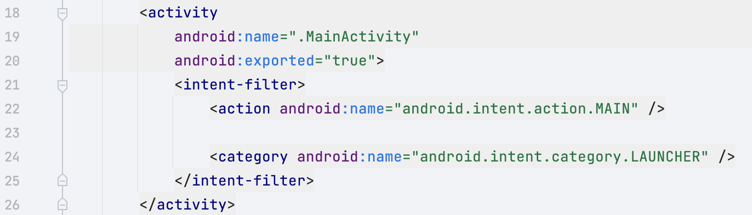
App Launcher
Every application must specify the activity that acts as the entry point with action.MAIN
It is done automatically when you first create an app, but there are cases when you might want to specify it yourself

Slide 13
Permissions
Common permissions are location, internet use, and user’s storage
You must specify all required permissions in the manifest file
<uses-permission
android:name="android.permission.ACCESS_FINE_LOCATION" />
There are two types of permissions : normal and dangerous
Normal permissions are automatically granted
Dangerous permissions have to be authorized by the user

Slide 14
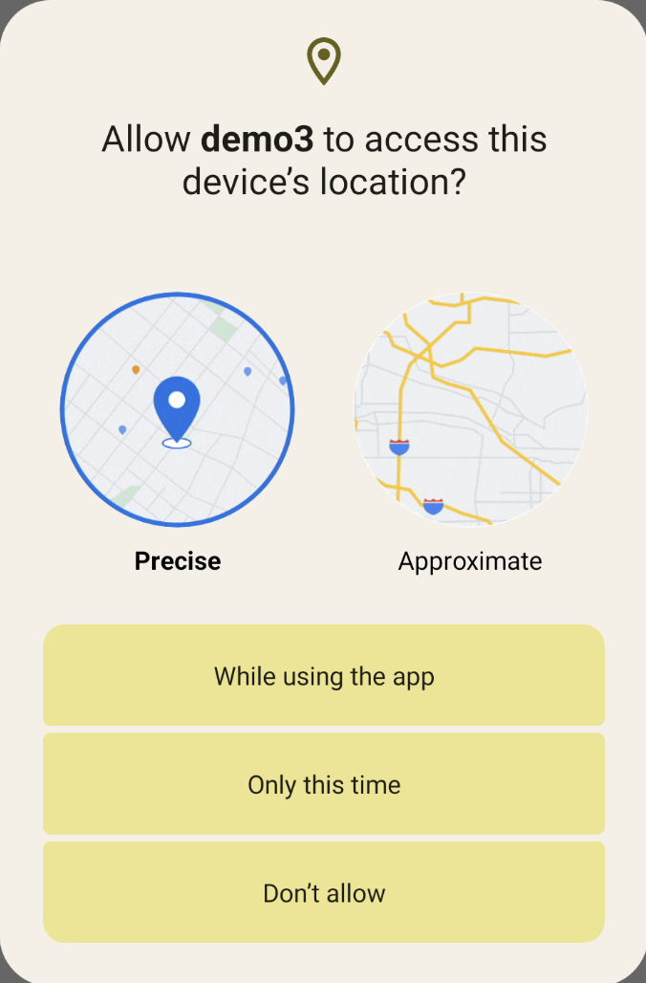
Dangerous Permissions
Grants runtime permissions to access restricted data
Enables the app to perform restricted actions that have a significant impact on the system
Ensures transparency while asking for permissions to alleviate user concerns

Slide 15
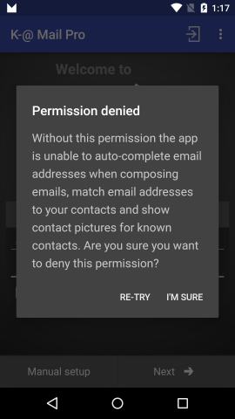
Permission Situations
Make sure that the app responds to all possible permission situations
These are the situations to account for:
User denies all permissions
User only allows permission with app is opened
User allows permissions always

Slide 16
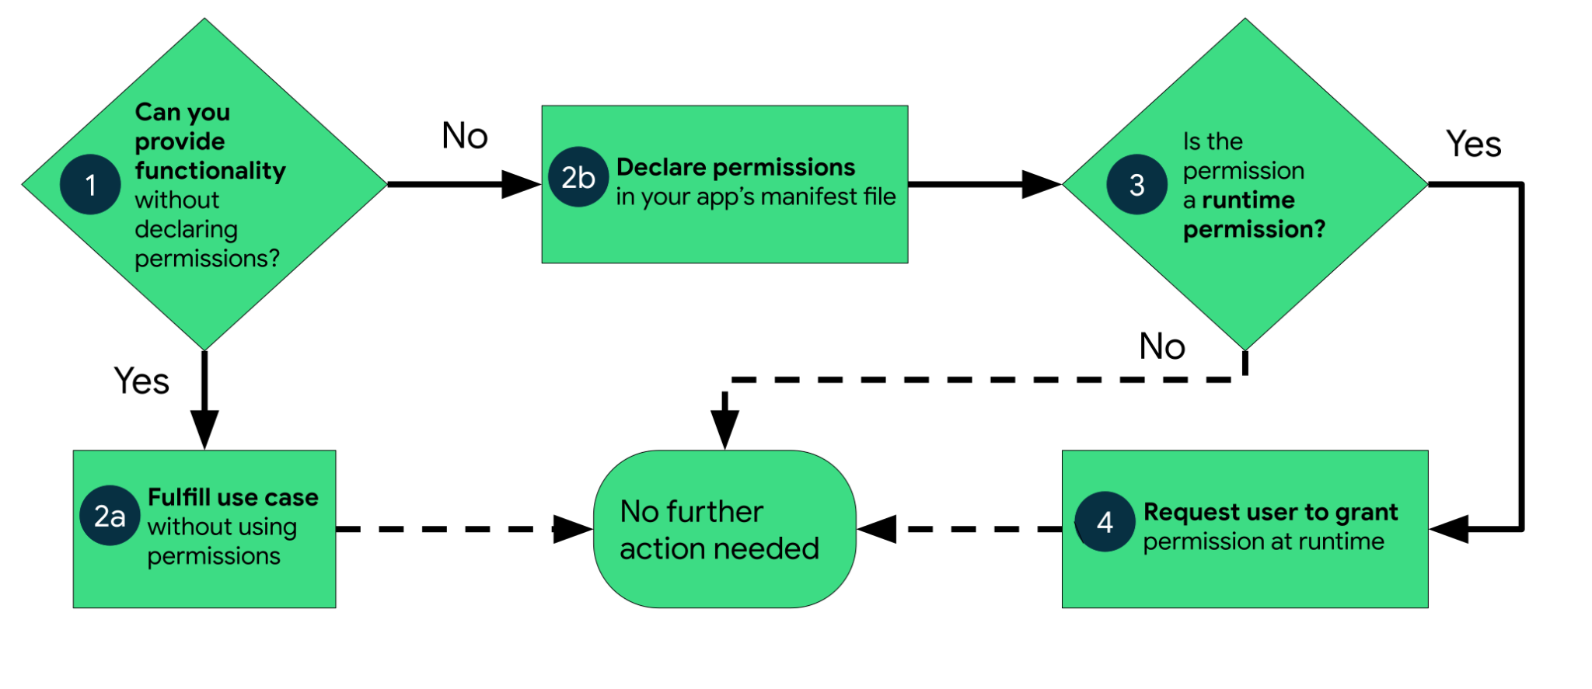
Flow Chart for Permissions Handling

Slide 17
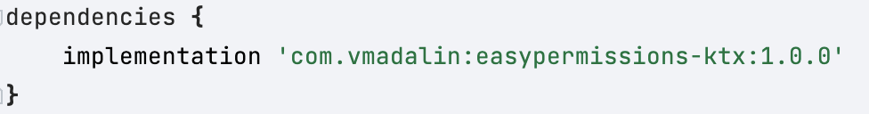
Permission Syntax
Syntax is very tricky and hard to remember, so please refer to the textbook
We will be using the EasyPermissions library to help with the tedious process
Step 1: Add dependency to the build.gradle

Slide 18
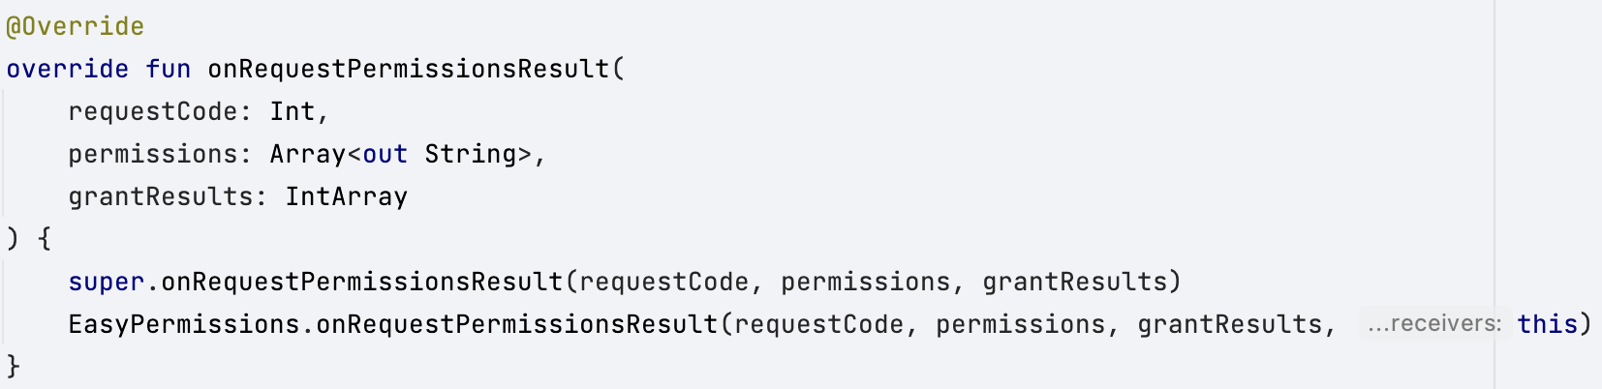
Permission Syntax
Step 2: Override Android’s default permissions handling flow

Slide 19
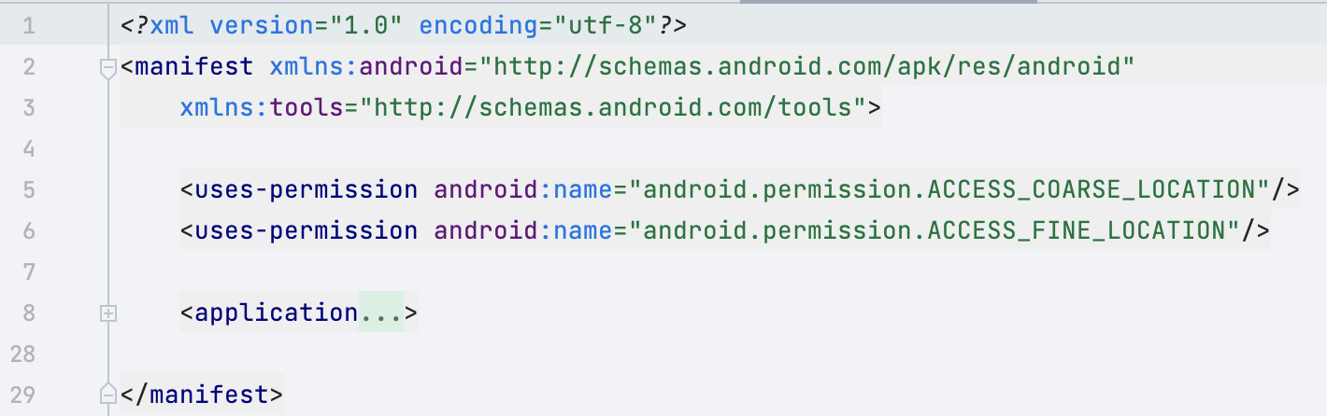
Permission Syntax
Step 3: Declare permissions in app’s manifest

Slide 20
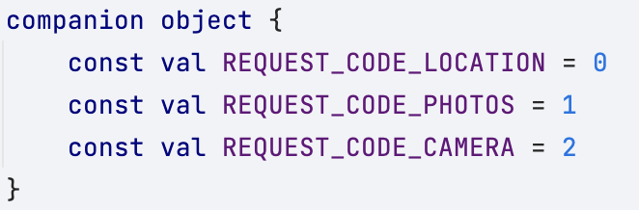
Permission Syntax
Step 4a: Make unique request codes for each permission
Used for the library to know where to go after permission is granted

Slide 21
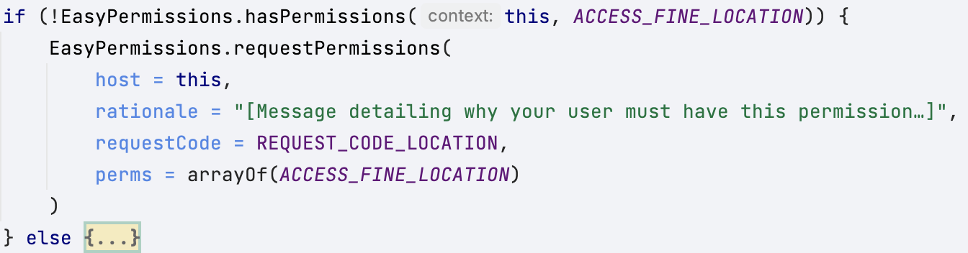
Permission Syntax
Step 4b: Handle the permissions flow (in onCreate)

Slide 22
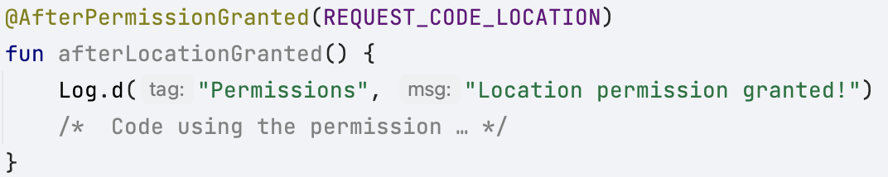
Permission Syntax
Step 5: Make a function that’s triggered on a permission being granted
@AfterPermissionGranted annotation makes the function trigger

